Slide 1
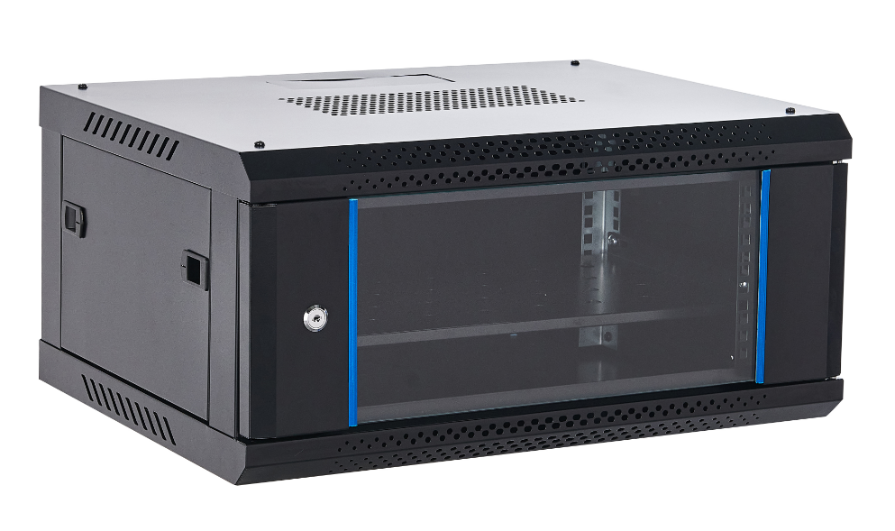
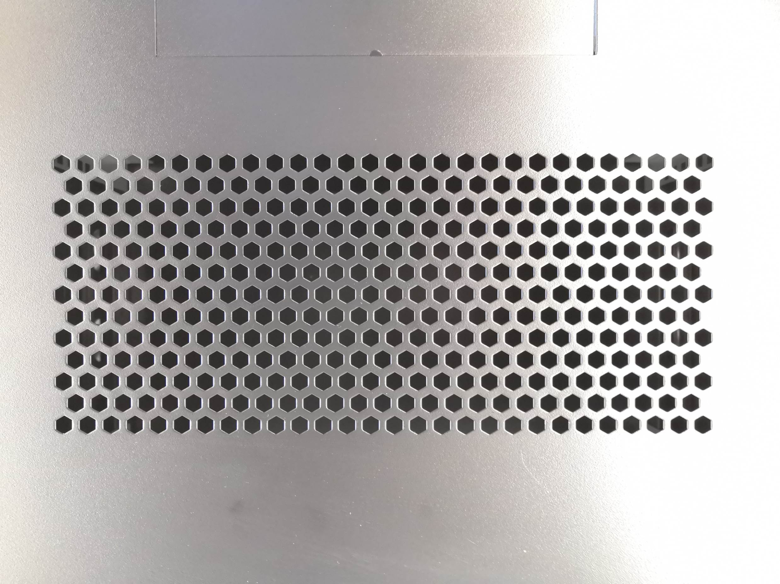
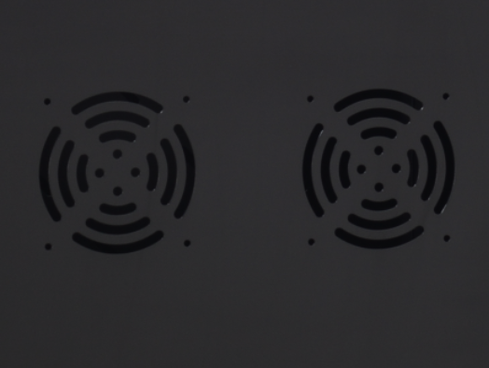
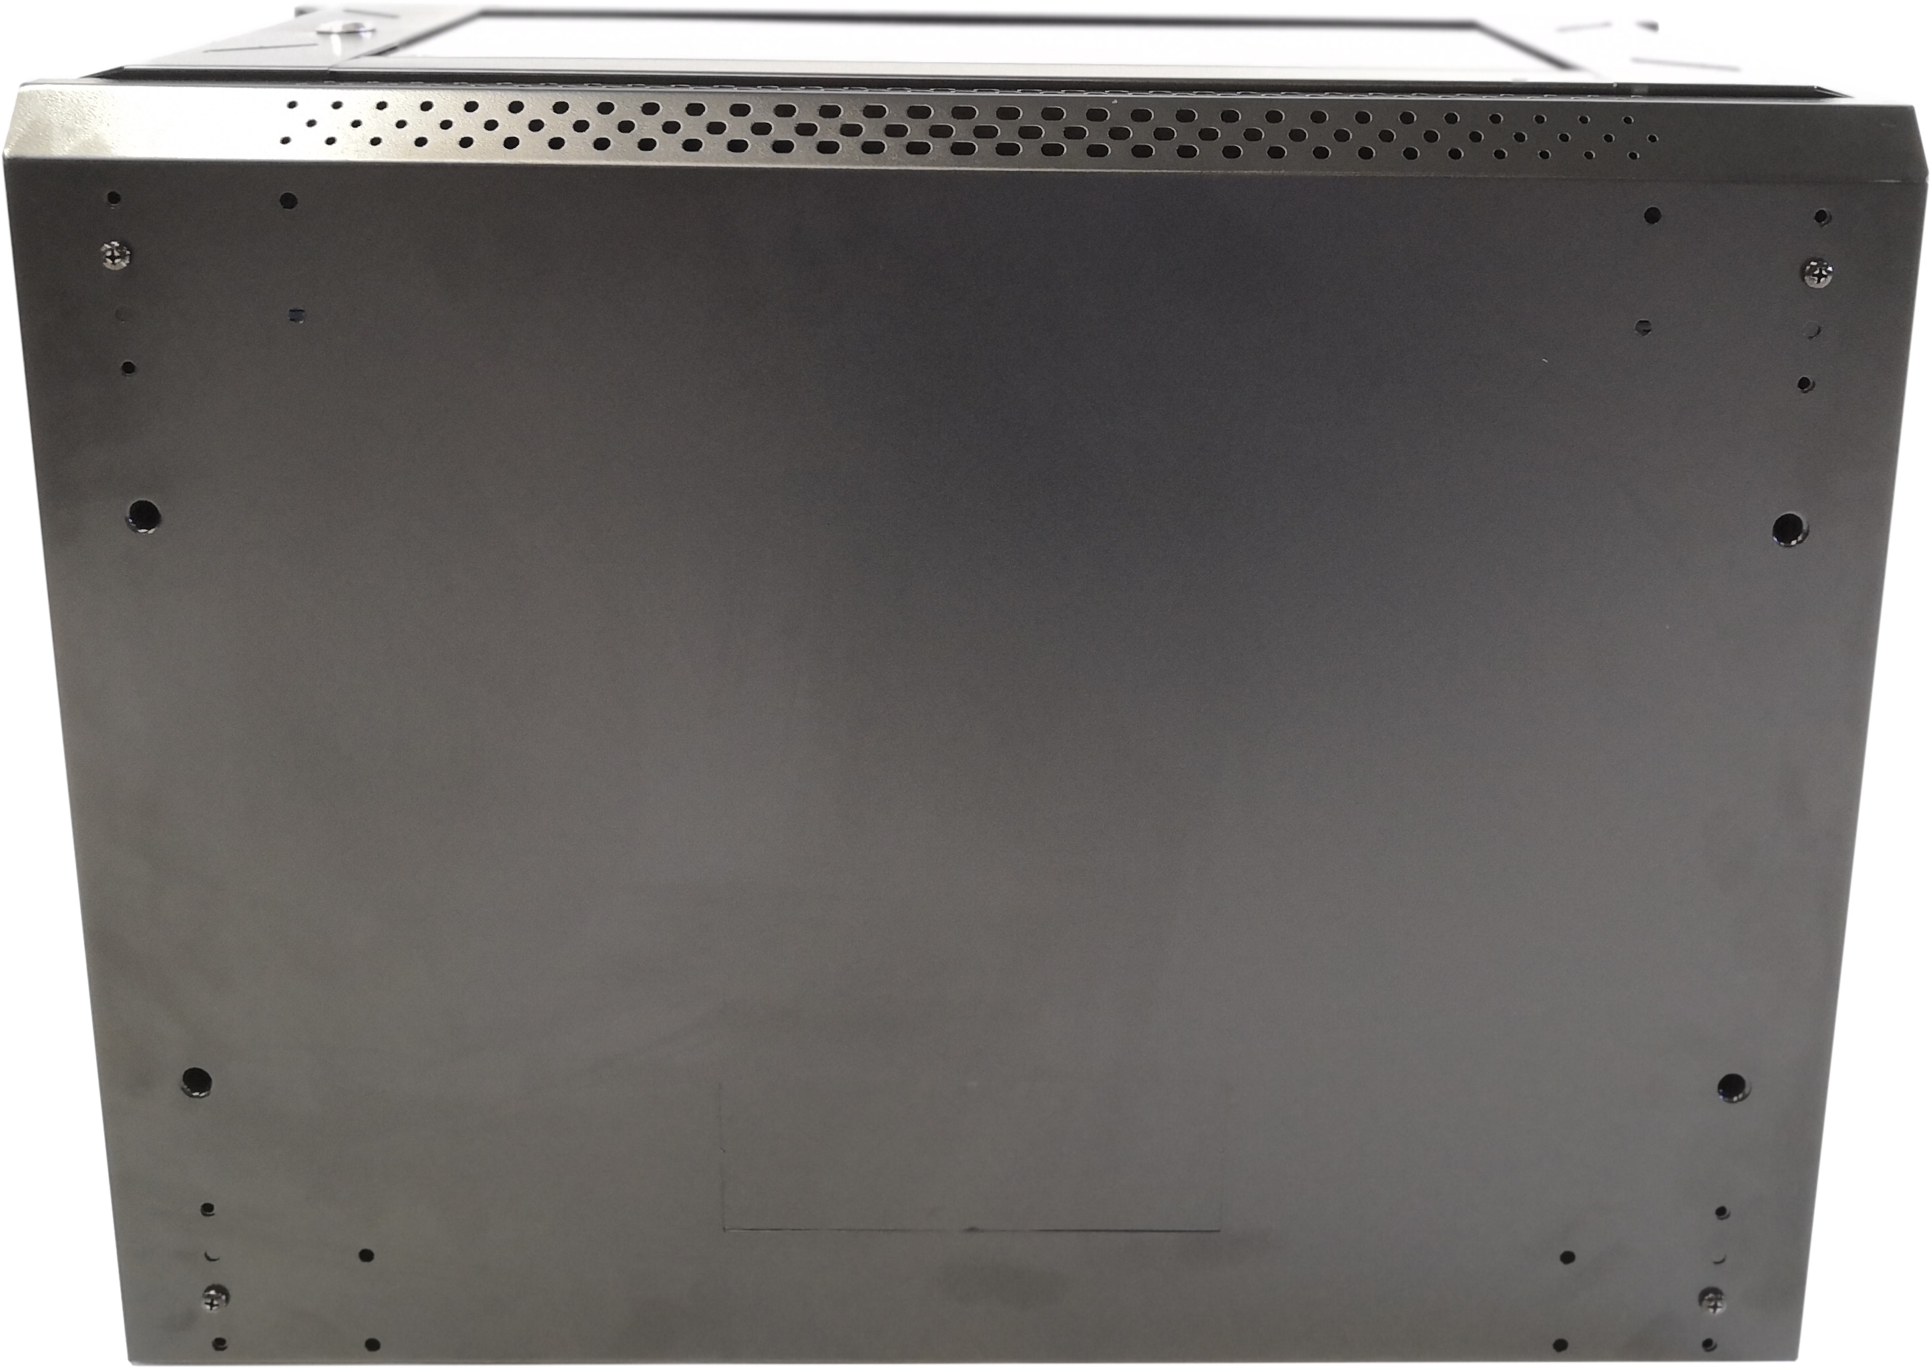
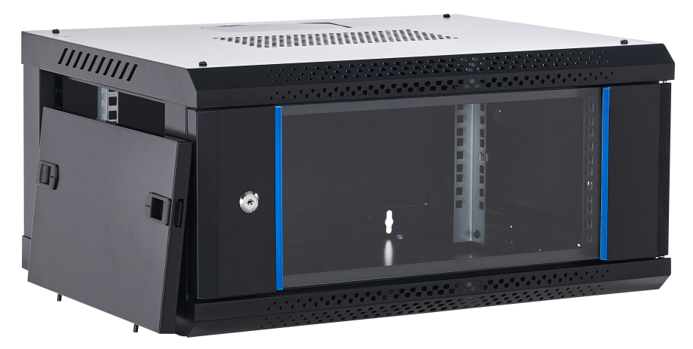
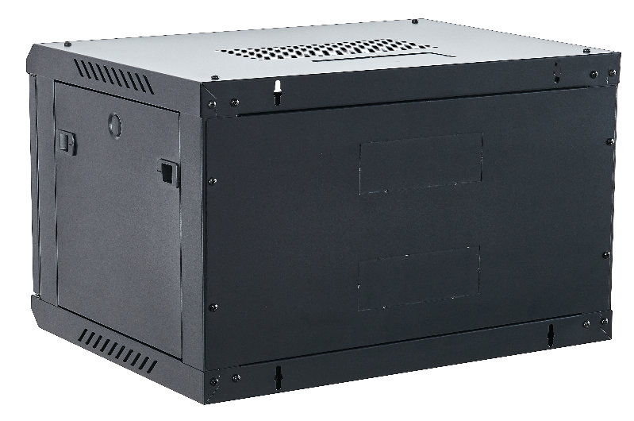
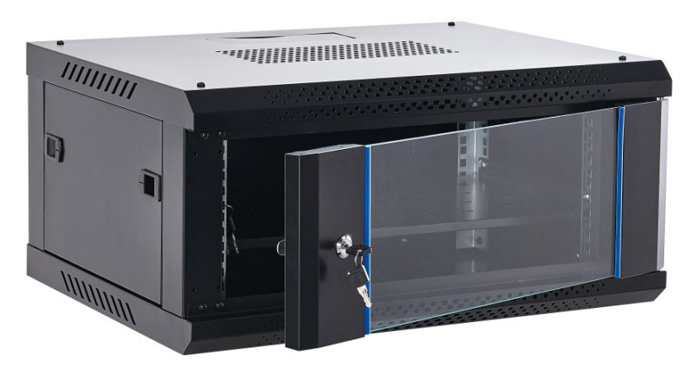
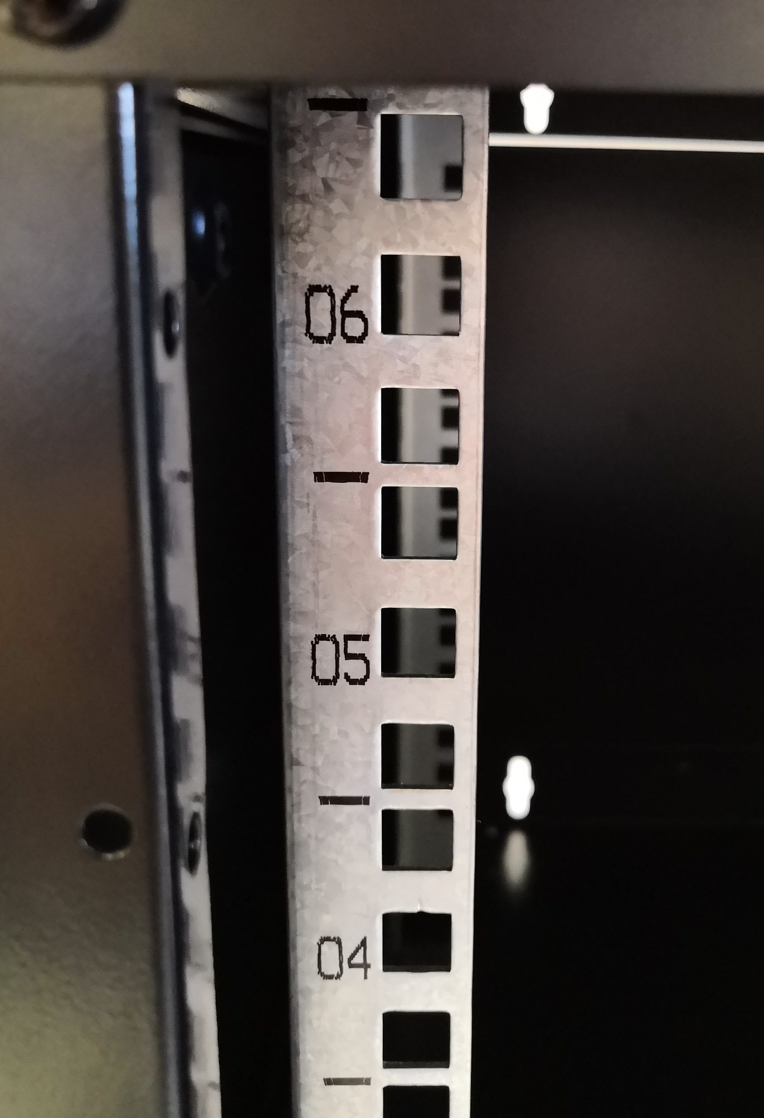
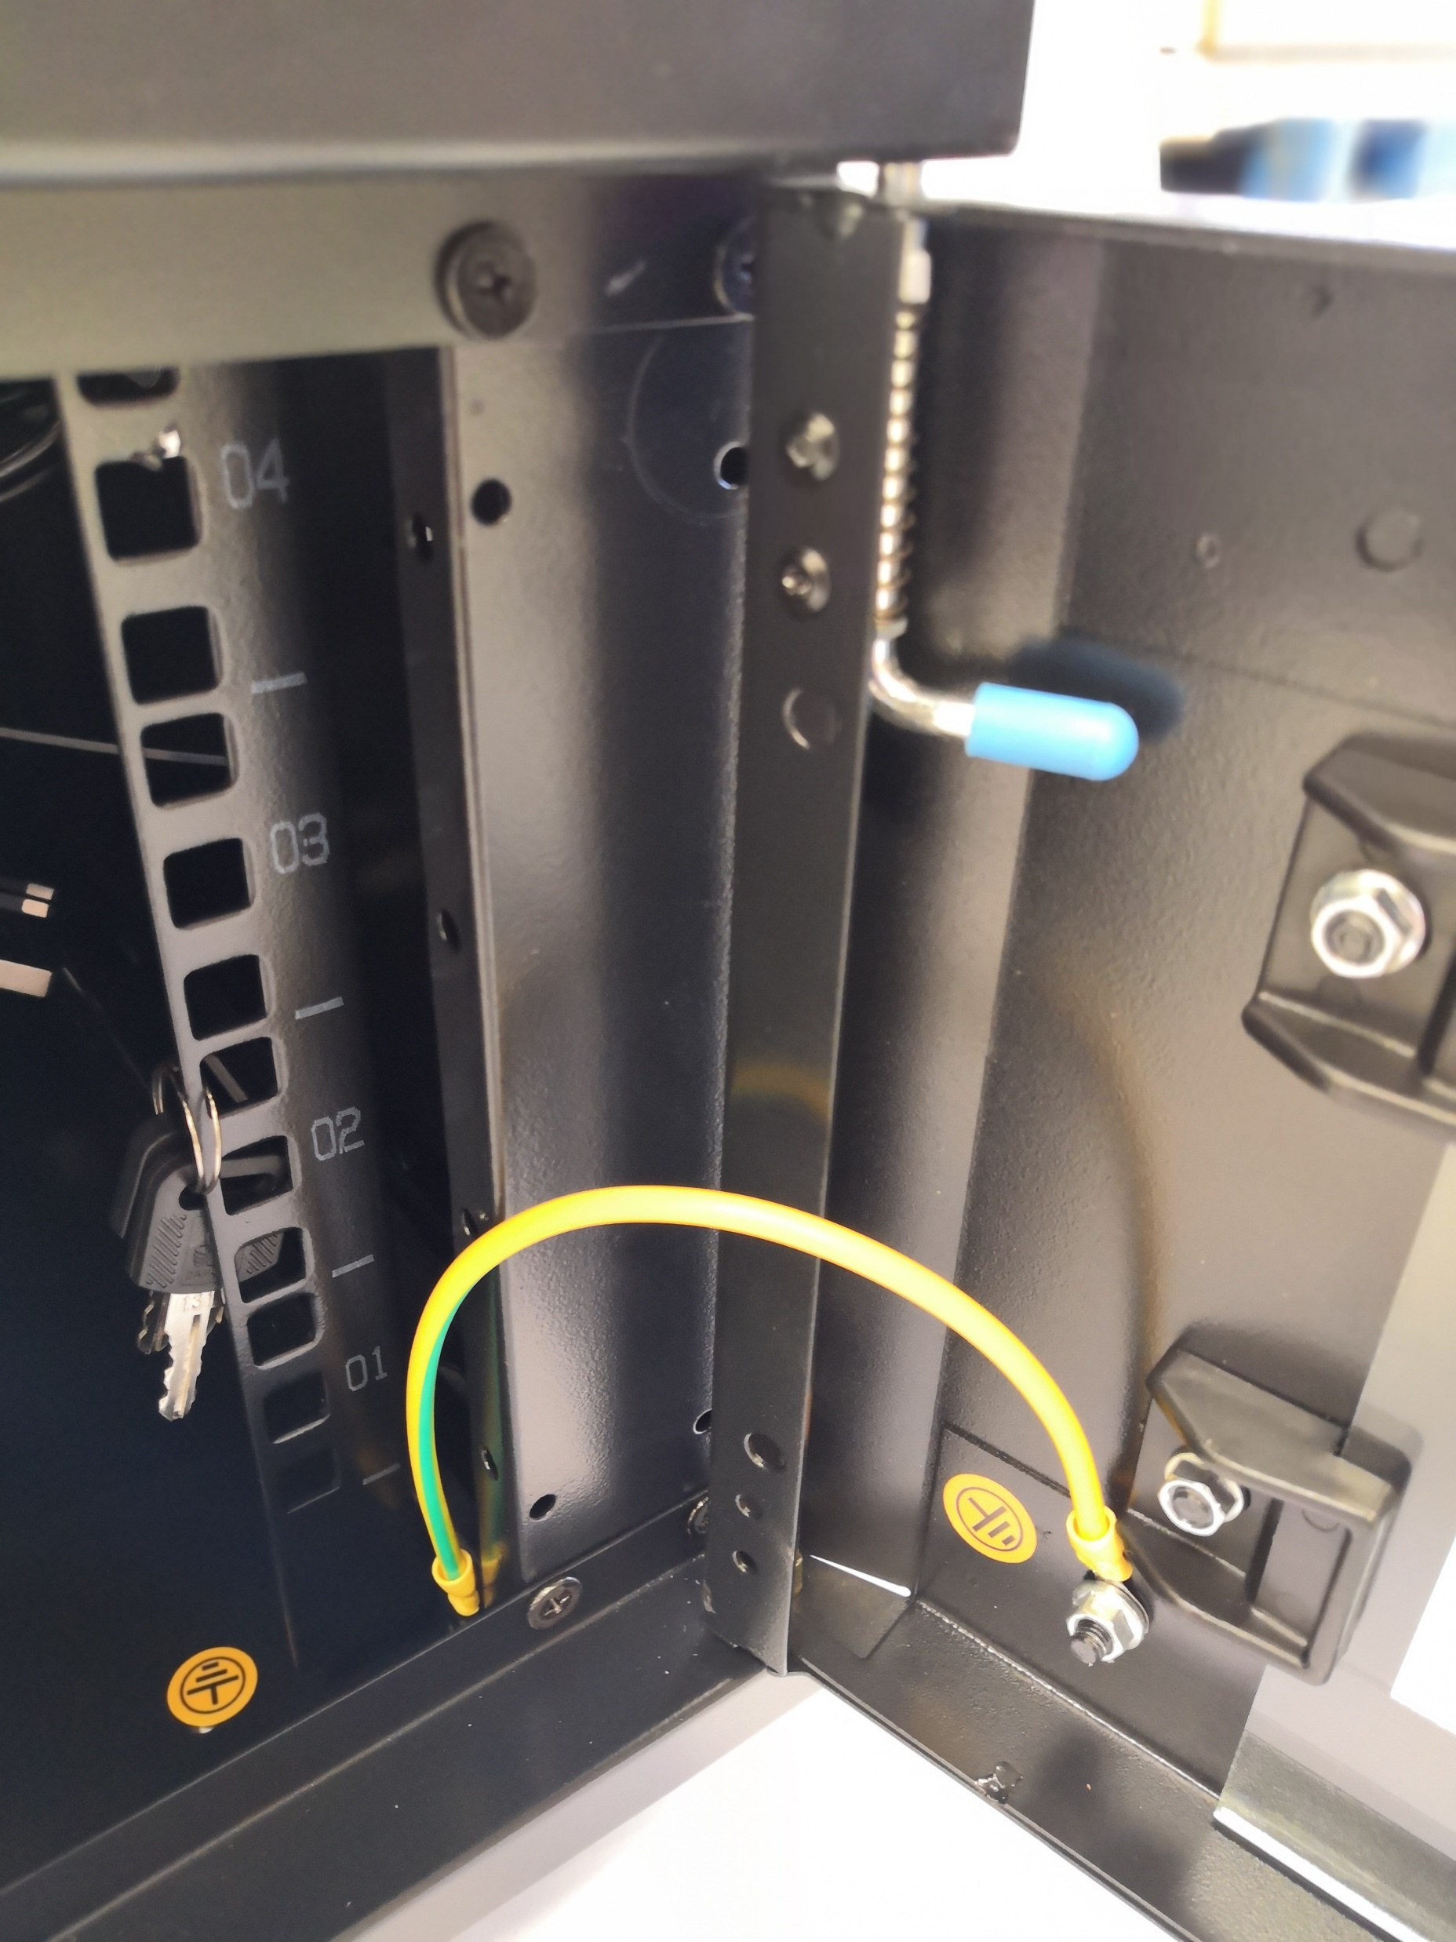
WB Single Section Wall Mounted Cabinets
Standard
Comply with ANSI/EIA RS-310-D, DIN41497 part 1, IEC297-2, DIN41494 part 7, GBIT3047.2-92 standard.
Feature
19 inch standard;
Removable Side Panels, side locks optional;
Knock off hole for entering cable on both top cover, bottom panel,real panel
Turning angle of front door is over 180 degrees
Easy mounting installation
Unassembled package saving shipping space
fans, shelf, PDU are optional
Loading Capacity
60KG
Degree of Protection
IP20
Material
SPCC Cold Rolled Steel
Thickness:1.0mm-0.8mm-0.6mm
Surface Finish:
Powder coating
Cabinet details
Fan exhaust hole
Bottom
Removable side panels
(Side lock optional)
Cable entrance on rear panel
Front tempered glass door
Zinc plated mounting profile with U mark
(Ground wire optional)

Slide 2
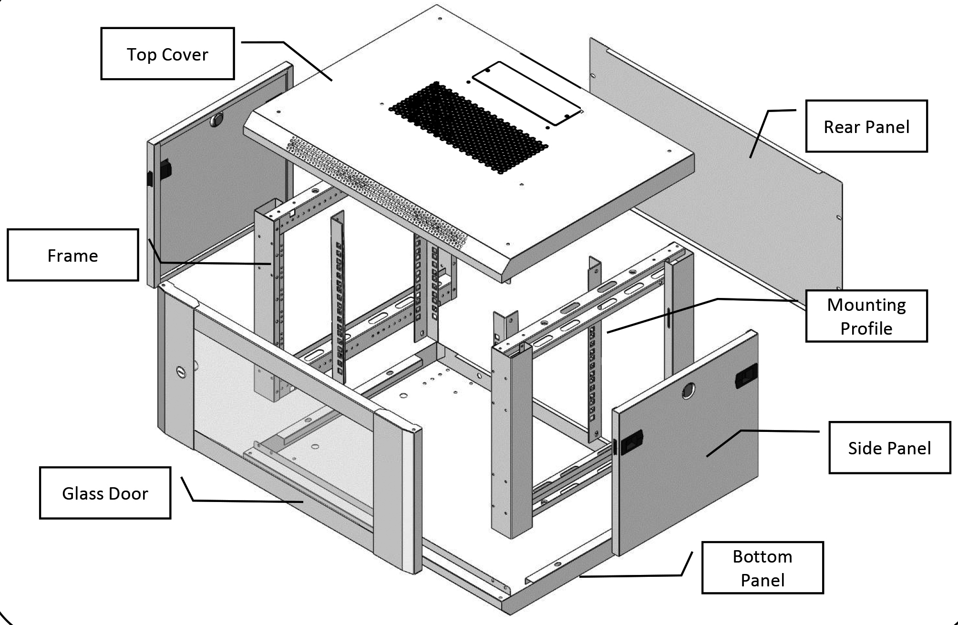
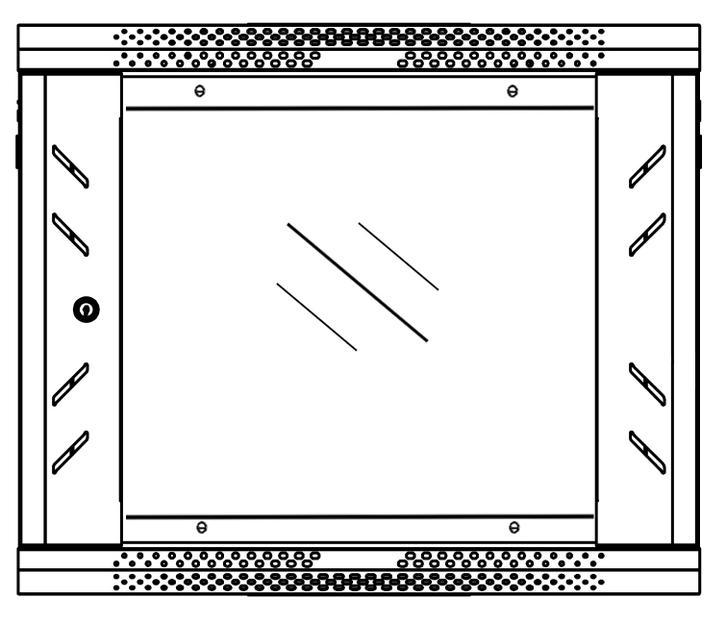
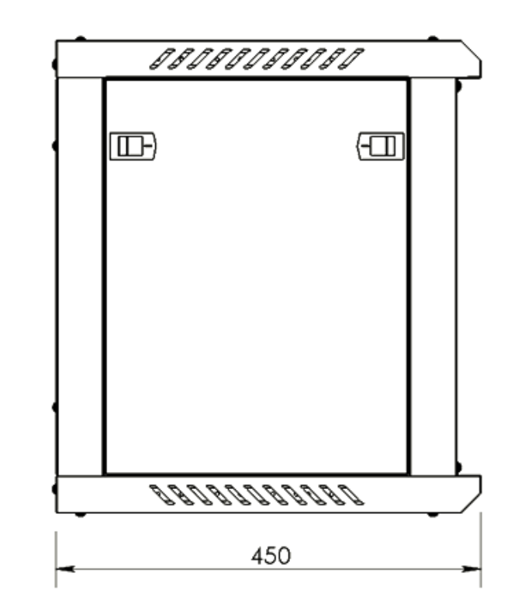
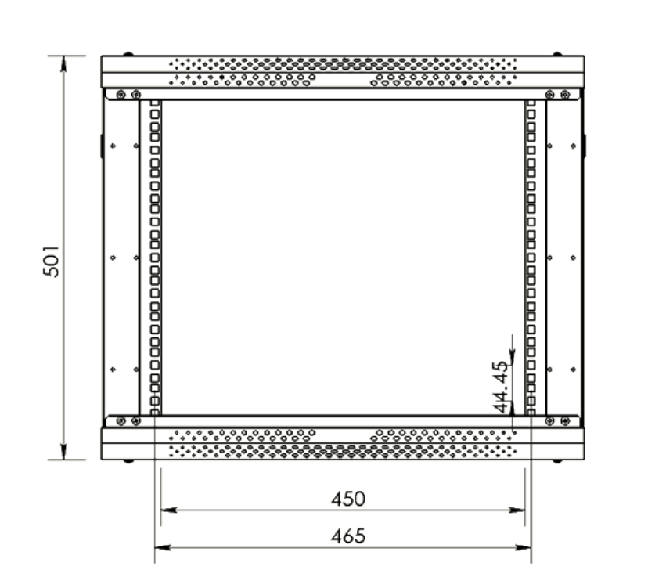
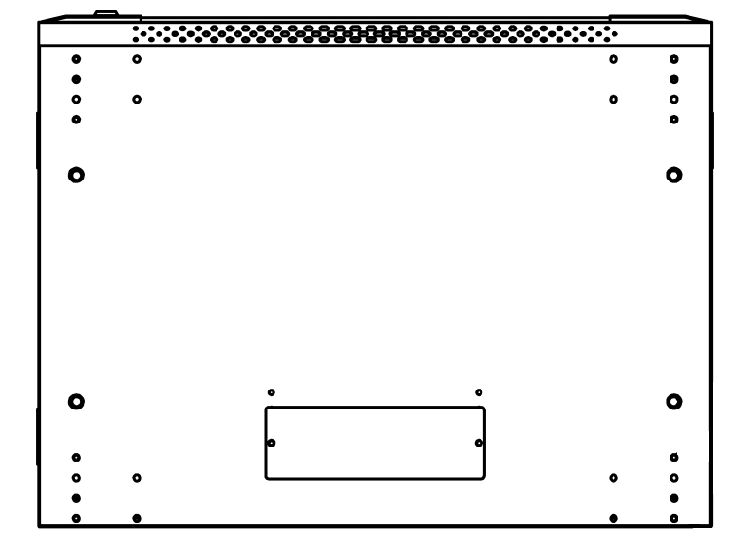
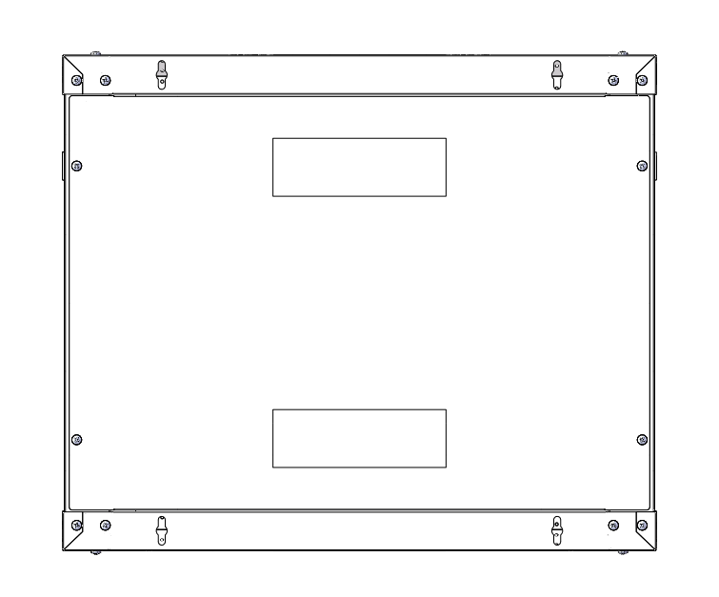
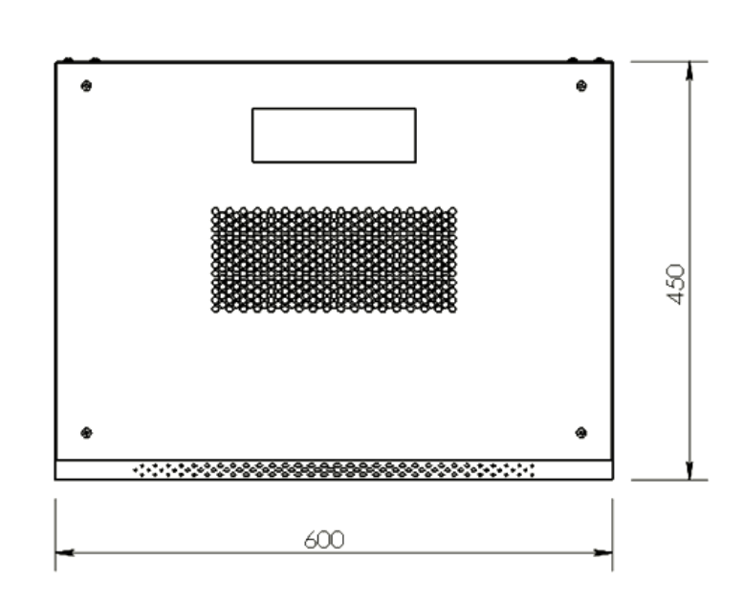
WB Single Section Wall Mounted Cabinets
Main dimension 9U 600*450*501mm
Front view
(Toughened glass)
Side view
Inside view
bottom
Back view
Top view

Slide 3
WB Single Section Wall Mounted Cabinets
Main Parts
S/N | Specification | Quantity | Unit | Material | Surface Finish | Remark
1 | Mounting profile | 4 | Piece | Coated Zinc plate t1.0 | Coated Zinc | with U mark
2 | Frame | 2 | Piece | SPCC cold rolled steel t0.8 | Powder coated
3 | Side panel | 2 | Piece | SPCC cold rolled steel t0.6 | Powder coated
4 | Top cover | 1 | Piece | SPCC cold rolled steel t0.6 | Powder coated
5 | Bottom panel | 1 | Piece | SPCC cold rolled steel t0.6 | Powder coated
6 | Rear panel | 1 | Piece | SPCC cold rolled steel t0.6 | Powder coated
7 | Front door | 1 | Piece | 5MM toughened glass door/SPCC t0.8 | Powder coated
8 | Lock | 1 | Piece | Steel | Color Zinc | with 2 keys
9 | M6 Square nut | 12 | Piece | Steel | Color Zinc
10 | M6 B-head screw | 12 | Piece | Steel | Color Zinc
11 | Allen wrench | 1 | Piece | Steel | Color Zinc
Specification
Model No. | Capacity | Width | Depth | Height | Packing dimension | Volume
 | (U) | (mm) | (mm) | (mm) | (mm) | (CBM)
WB.6404 | 4 | 600 | 450 | 280 | 635*485*160 | 0.049
WB.6604 |  |  | 600 |  | 635*635*230 | 0.093
WB.6406 | 6 | 600 | 450 | 368 | 635*485*160 | 0.049
WB.6606 |  |  | 600 |  | 635*635*230 | 0.093
WB.6409 | 9 | 600 | 450 | 501 | 635*485*235 | 0.072
WB.6609 |  |  | 600 |  | 635*635*231 | 0.093
WB.6412 | 12 | 600 | 450 | 635 | 665*595*236 | 0.093
WB.6612 |  |  | 600 |  | 665*635*231 | 0.098
Color
RAL9004 | RAL7035
black | grey

